Slide 1
Small Church Tax Reporting alsbom.org/ccs Click on Administrator Resources
Alabama Baptist State Board of Missions
Lee Wright
334-613-2241, lwright@alsbom.org

Slide 2
Resources
Alabama Baptist State Board of Missions, Church Compensation Services, LeaderCare & Church Health, Lee Wright 800-264-1225 ext 241, cell 334-549-1383, or direct line 334-613-2241, lwright@alsbom.org
Church Compensation Services – www.alsbom.org/ccs Salary Study, events, blogs
Follow the State Board of Missions on Facebook or Twitter for news, events, etc.
GuideStone – www.guidestone.org
GuideStone financial resources - www.guidestone.org/compensationplanning

Slide 3
Reporting for the Bivo Pastor
Can all my income be in housing? Yes, if that is appropriate for your situation.
Is there a limit to housing? No percentage, can be up to 100% if appropriate
Should I have 100% in housing? No, have some as taxable so that you may participate in the Church Retirement Plan
If 100% is housing, do I need a W-2. No. A memo on church letterhead
If I have some taxable income, do I receive a W-2 or a 1099? W-2. Pages 105-106

Slide 4
What other forms are needed?
If the pastor is the only employee and has only housing, no additional IRS forms are required. Memo statement for housing.
If the pastor is the only employee & has salary and housing
Only a W-2 (and W-3, A-3)
If there are other employees such as a secretary
941 each quarter and corresponding AL form A-1
W-2 (not a 1099)
End of the year forms W-3, A-3

Slide 5
IRS Rules Unique to Churches
Ministers have a “dual tax status.”
A minister’s compensation is exempt from withholding.
Ministers are eligible for a housing allowance
Ministers deserve maximum tax benefits. Due to recent tax changes, for many ministers, the benefit of the housing allowance is overshadowed by paying all of the Social Security taxes
Page 6

Slide 6
Overview of the Process
Determine which workers are employees and which are contract workers
Determine which are ministers for tax purposes
Among employees, determine which are exempt and which are non-exempt. Ministers are usually exempt, support staff are usually non-exempt
Page 7

Slide 7
Determine if employee or contract
Degree of control employer has over details of the work
Which party invests in the facilities used for work?
Opportunity the worker has for profit or loss
Whether employer has right to discharge the worker
Whether the work is part of employer’s regular business
Permanency of the relationship
Relationship the parties think they are creating
See Financial Issues, page 7

Slide 8
Classification common mistakes
Classifying as a contract worker a person who should be an employee
If in doubt, the IRS and DOL are both leaning more and more toward classifying as an employee in recent rulings.
A person who does 2 jobs at the church will generally be classified as an employee for both unless there is a clear reason to do otherwise. Example: Mary the church pianist also operates Mary’s lawn service. The lawn service could be given a 1099.

Slide 9
4 Forms needed + E-Verify, p 8
W-4 Federal withholding. - www.irs.gov
A-4 Alabama Withholding - www.revenue.alabama.gov
I-9 Immigration Form - www.uscis.gov/I-9
E-Verify. USCIS web site at www.uscis.gov/everify or Alabama http://verify.Alabama.gov
NH 1 Alabama New Hire Form - www.dir.alabama.gov/nh

Slide 10
Most common mistakes
Failing to do the forms at all – if so, start by completing the first 3 on all current employees. Keep these on file.
Failing to complete the forms on a minister. A minister is an employee in every way except Social Security taxes.
Failure to do E-Verify which is required by Alabama Immigration Law

Slide 11
Determine if Exempt or Non-Exempt Fair Labor Standards Act
Church Tax Workshop

Slide 12
Purpose of FLSA
Establishes minimum wage & overtime standards
Distinguishes between covered (non-exempt) and excluded (exempt) employees
Establishes overtime threshold (40 hr.)
Specifies record-keeping requirements
See Financial Issues page 8

Slide 13
Types of Positions
Exempt – not covered by FLSA
Non-Exempt – covered under FLSA for time-and-one-half overtime
Ministers are always exempt even if they do not meet the salary test
Page 8

Slide 14
Exempt Positions
Exempt employees paid for job, not hours worked
Must meet salary basis test
Salary must be more than $844 per week. Going to $1128 per week January 1

Slide 15
Exemption Test
Based on primary duties, not title
most important duties that account for 50% of time spent working
Regularly exercises discretion and independent judgment
Paid on a salaried basis for the job, not the number of hours worked

Slide 16
Non-Exempt Employees
Time-and-one-half Overtime
Based on WORKED time (not leave time)
Employee has WORKED over 40 hours in a work week
Paid at 1-1/2 times the employee’s regular rate of pay for each hour worked beyond 40

Slide 17
Examples of Compensable Time
UNAUTHORIZED WORK
Work not requested but “suffered or permitted” is counted as time worked
Standard is whether the employer knows or has reason to believe the work is being performed

Slide 18
Potential DOL Penalties
Unpaid wages (2 - 3 years of back wages)
Fines ($10,000)
Imprisonment (6 months)
Liquidated damages (2x)
Attorney’s fees and costs
Individual liability
Notes:
2 years back wages
3 years if willful violation

Slide 19
Fair Labor Standards Summary
Must pay for all hours worked. Example: daycare teacher who eats lunch with the children; receptionists who answers phone while eating lunch; secretary that runs copier on Sunday morning for SS teachers
You must pay time and a half for hours over 40 worked in a 7 day look back period.
You may not give comp time (except in the same 7 day work week).
Salaried employees are covered just as hourly employees are.
A bookkeeper could not be treated both as a paid employee and an unpaid volunteer bookkeeper for the same institution.

Slide 20
Fair Labor Standards Summary
A church secretary may not be paid and volunteer as church clerk
Must maintain adequate records for non-exempt (see page 11)
The Act requires covered employers to pay males and females the same compensation for the same work.
The burden of proof is one the employer

Slide 21
What is not covered by FLSA
Breaks
Meal periods
Vacation, holidays, severance
Sick days
Premium pay for working holidays
Note that meal periods are off the clock if the employee could leave; breaks, if provided, are on the clock
Note: breaks and meals are covered by the Alabama Child Labor Law for workers under 18.
See page 11

Slide 22
Is it taxable?
“Everything is taxable unless the Internal Revenue Code says that it isn’t.”
Frank Sommerville, CPA and attorney
See the chart in Financial Issues, page 22.
Most Common Mistakes:
Many are doing business expenses, medical, and benefits incorrectly.
The “package approach” results in more taxable income.

Slide 23
Most common mistakes-taxable
Failure to include Bonus and Love offerings. Include on the W-2. Do not do a separate 1099
Failure to include Gift cards from the church as taxable
Treating as tax free wrong type of health coverage.
Many churches have health reimbursements especially for ministers. According to our phone calls, 95% are incorrect.
Treating as tax free wrong type of life insurance

Slide 24
Payment of Individual Insurance
Health insurance premiums paid by the employer or reimbursed to the employee for individual plans is taxable with some exceptions:
Group plans remain a tax free benefit
GuideStone remains a tax free benefit
There is an exception for groups fewer than 2 employees
2 New HRA Provisions
See Financial Issues Book, page 21, 69-70

Slide 25
QSE HRA
The Qualified Small Employer HRA is not a group health plan. A QSE HRA is an arrangement offered by an eligible employer that meets the following criteria:
The arrangement is funded solely by an eligible employer, and no salary reduction contributions may be made under the arrangement.
The arrangement provides, after the employee provides proof of coverage for the payment to, or reimbursement of, an eligible employee for medical care expenses incurred by the employee or the employee’s family members
The amount of annual payments and reimbursements do not exceed $5,300 ($10,700 for family)

Slide 26
Qualified Small Employer HRA
A QSE HRA meets the following criteria:
The arrangement is provided on the same terms to all eligible employees of the eligible employer.
To be an eligible employer that may offer a QSE HRA, the employer may not be an applicable large employer (ALE) and may not offer a group health plan to any of its employees.
Written plan and 90-day notice required.

Slide 27
Another new HRA - ICHRA
An Individual Coverage HRA has more flexibility than a QSEHRA.
It may cover individual insurance premiums and out of pocket costs. QSEHRA is only for insurance premium.
It may cover different classes of people – salaried, hourly, full time, part time
Generally tax free except to pay for a Christian sharing ministry plan.

Slide 28
Ministry Assistant Mary Smith
Mary Smith serves as the part time ministry assistant for the church. Her salary is $12,000.
In addition, the church contributes $1000 to her church retirement plan
Also, through a Salary Reduction Agreement, she contributes $1000 to her church retirement plan
The church provides $25K in Group Term Life Insurance (less than $50K, not taxable)

Slide 29
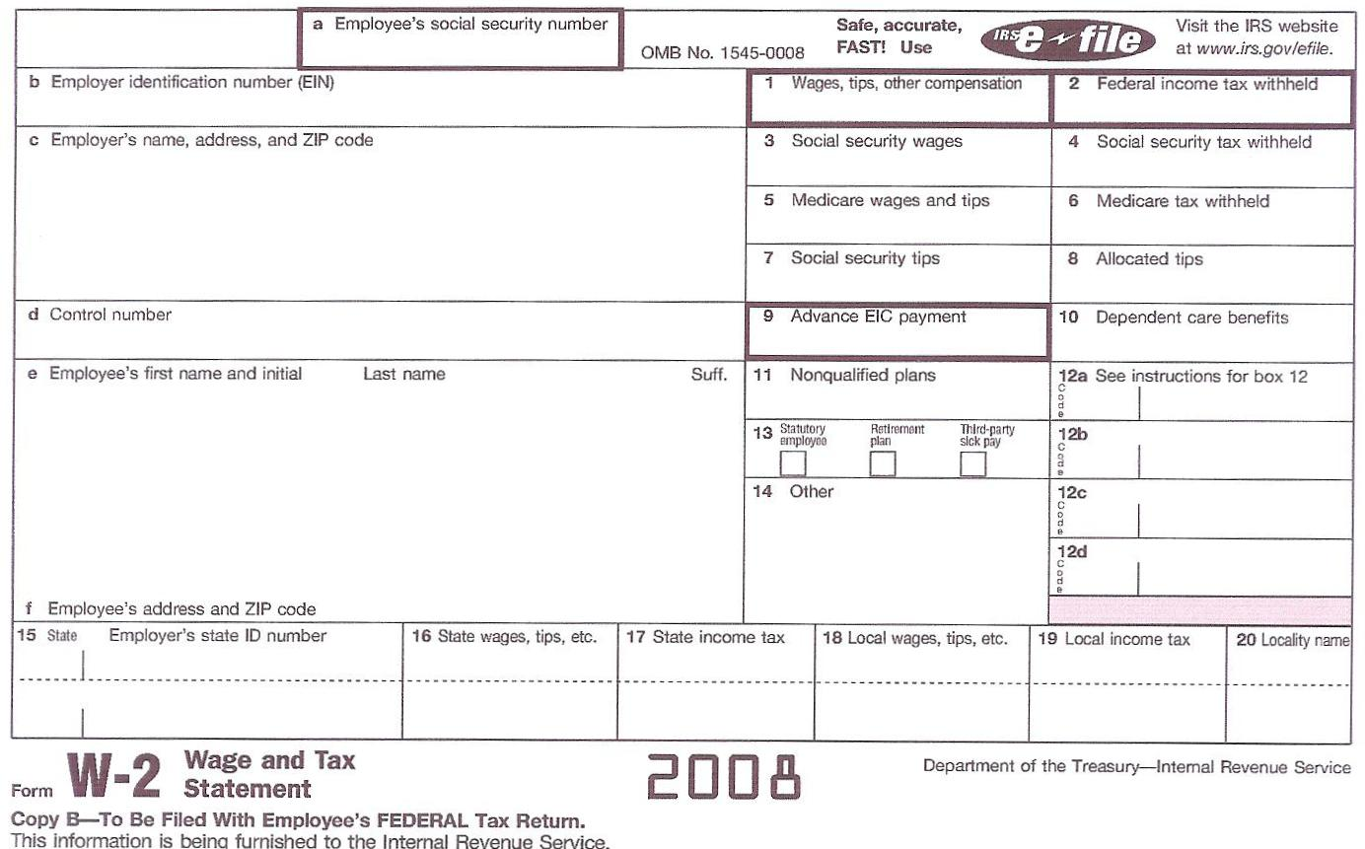
Mary Smith W-2, see page 21
$11000.00
$600.00
$12000.00
$744.00
First Baptist Church
101 Main Street
Anytown, AL
$12000.00
$174.00
E 1000.00
Mary Smith
334 Main Street
Anytown, AL
$11000.00
$0.00

Slide 30
W-2 most common mistakes
Failure to include bonus or love offering in box 1,3,5 and 16.
Do not put bonus or love offering in box 14
Do not put bonus or love offering on a 1099 for an employee
Failure to properly handle retirement contributions: ER contributions not on W-2; EE contributions – 3, 5 and 12

Slide 31
Pastor Jones
Pastor Jones is the minister of First Baptist Church, Anytown, Alabama. He has a salary of $25,000 of which he has requested $15,000 in housing allowance and has signed a $2,000 salary reduction agreement for GuideStone church retirement plan contributions.
The church provides health insurance as a benefit for Rev. Jones and $1000 contribution to Church Retirement Plan

Slide 32
Pastor Jones group term insurance
The church provides $50,000 in term life insurance through GuideStone
Looking at the table in IRS Publication 15-B, page 11, the taxable amount will be $0
Note: The IRS only allows Group Term Life and has a 10 Employee Rule. There are exceptions to the 10 Employee Rule. GuideStone Term Life is group term even if fewer employees than 10. See IRS Pub 15-B

Slide 33
Pastor Jones W-2, see page 24
$8000.00
Note that boxes 3,4,5,6 are blank
First Baptist Church
101 Main Street
Anytown, AL
E $2000.00
DD $5000.00
Pastor Jones
301 Broad Street
Anytown, AL
√
Housing Allowance $15,000.00
$8000.00

Slide 34
Minister W-2 common mistakes
Failure to include bonus or love offering in box 1 and 16.
Do not put bonus or love offering in box 14
Do not put bonus or love offering on a 1099 for an employee
For an ordained minister, box 3, 4, 5 & 6 are always blank

Slide 35
Minister W-2 common mistakes
Improperly handling housing allowance on W-2 (Box 14 or not on W-2)
Failure to properly handle retirement contributions: ER contributions not on W-2; EE contributions – box 12
Failure to include Non accountable business expenses (car allowance concept). Should be included in box 1 and 16
Improperly handling health reimbursements which are taxable (unless correctly done)

Slide 36
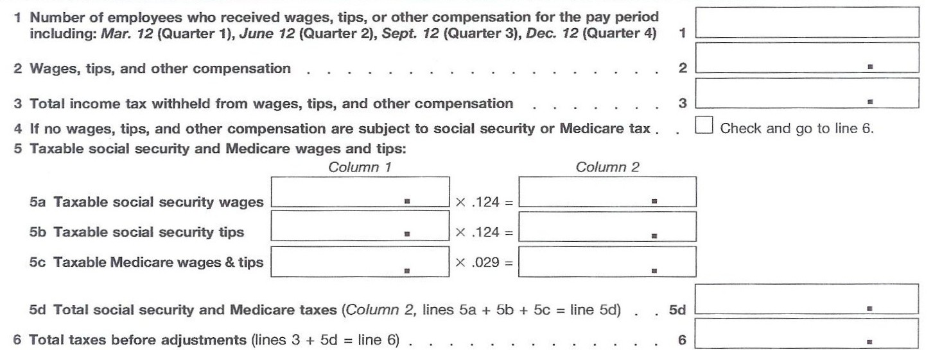
Form 941, part 1
1. Number of employees
2

Slide 37
Form 941, part 1
Pastor $2000 +
Mary $2750 =
2. Wages, tips & compensation
Good news! The IRS does not reconcile Box 2 with anything.
2
$4750.00

Slide 38
Form 941, part 1
Pastor $0+
Mary $150=
3. Total Income Tax withheld
2
$4750.00
$150.00

Slide 39
Form 941, part 1
Pastor $0 +
Mary $3000
5a. Taxable Social Security Wages
2
$4750.00
$ 150.00
$3000.00
$372.00
$0.00
$0.00
$3000.00
$87.00
$459.00
Notice that Mary’s Contribution to her Church Retirement Plan did not reduce her wages subject to Social Security and Medicare
$609.00

Slide 40
941 common mistakes
Minister should be included in EE count, line 1
Minister wages included line 2 (but not housing)
Minister federal withholding included in line 3 (if he requests withholding)
Minister wages not included in lines 5
Addition mistakes
Failing to deposit taxes monthly (or more often) when required. Small churches can often send the payment quarterly if less than $2500.

Slide 41
Pastor – Taxable? On W-2?
Salary - $8000 – Box 1 & 16 of W-2
Plus $12 taxable amount group term life
Housing - $15000 – Not on W-2
But may be placed in Box 14 labeled housing
Church contribution retirement $1000 – NO. employer contributions not listed on the W-2
Retirement SRA $2000 – Box 12
Health Insurance listed in Box 12. Optional. Only required by employers over 250 EEs.

Slide 42
Additional Steps
Alabama A-1 - Quarterly
Alabama A-3 – Annual (similar to W-3)
W-3 – Annual – totals amounts on W-2s
Form 944 – Employer’s Annual Federal Tax Return (only if instructed to do so by the IRS)
1099s and 1096 Transmittal form if you have any contract workers and the Alabama form 96
Page 14-18

Slide 43
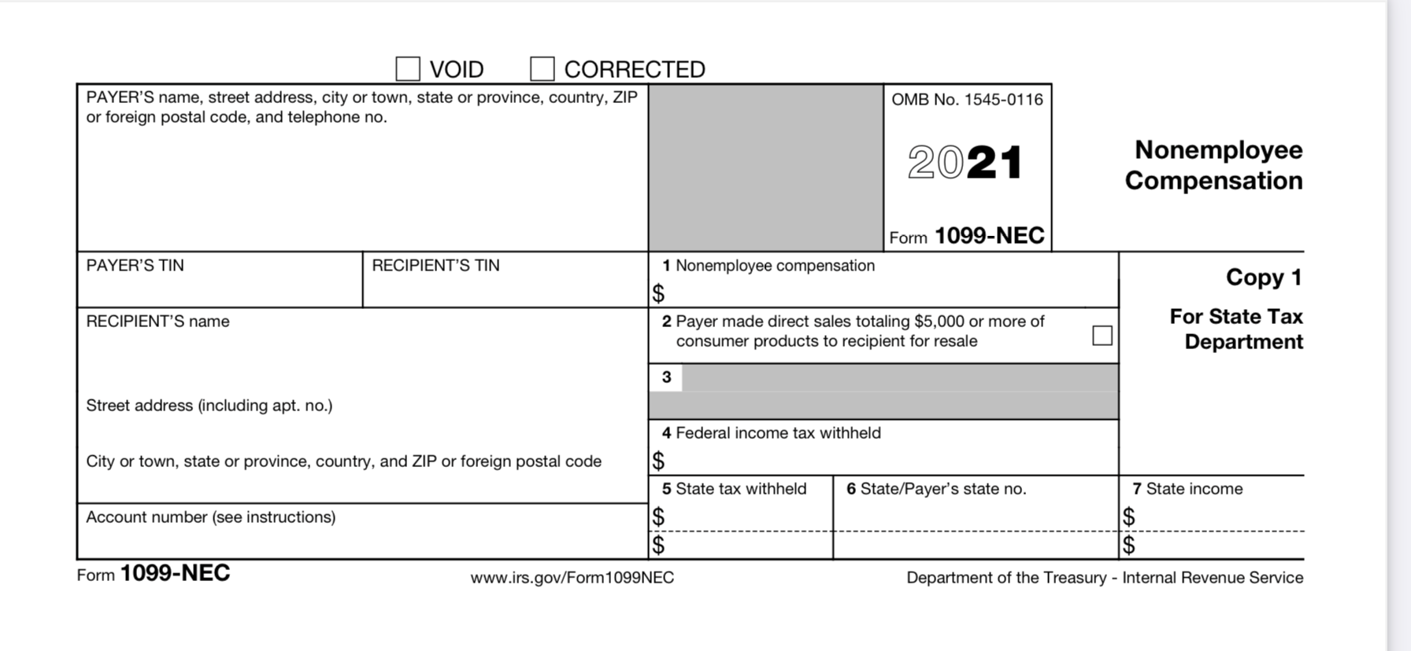
Contract Worker-Form 1099-NEC

Slide 44
Form 1099 common mistakes
Classifying as a contract worker a person who should be an employee
A person who does 2 jobs at the church will generally be classified as an employee for both unless there is a clear reason to do otherwise.
Using a 1099 MISC instead of 1099 NEC
Failure to first obtain a W-9

Slide 45
1099 mistake failure to obtain a W-9
Be sure to obtain a W-9 on any person you will pay.
This will let you know whether the person is incorporated or not
Will provide for you Tax ID number or SS number
If you do not have a SS number, you still must provide a 1099. Your church will be penalized for providing a 1099 without a SS number
You are required to do backup withholding of 28% if you have no SS number.

Slide 46
New W-4 form
For most people, there are really only 3 considerations
Filing status, married filing jointly, filing separately, head of household or single
Standard deduction
Child tax credits
Simple for the employee. Complete Step 1 personal information and filing status and Step 5 Signature. The rest is optional.

Slide 47
New W-4 form
Step 1. Personal Information and filing status
Step 2. Multiple jobs. (Married filing jointly for example). The employee can simply check the box. This will claim half of the standard deduction for each spouse and both are instructed to check the same box. This is the easiest answer. On page 7 of the instructions, Married filing jointly will claim the full $25k or with box checked will claim about $12.5k. Getting this wrong will cause severe underpayment of tax!
Step 3. Child Tax Credits – each child under 17
Step 4. Adjustments for extra deductions or for extra withholding
Step 5. Sign and date

Slide 48
2024 Estimated Tax for Minister
2021 Estimated Taxes for Ministers Living in a Parsonage
Federal Income Tax Estimate
Salary (don’t include housing) $________________
Bonus/love offering $________________
Social Security offset $________________
Taxable benefits such as non-accountable car allowance, $________________ health plan that doesn’t qualify, etc.
Estimate income from weddings, funerals, revivals, etc. $_________________
6. Total Minister Income Subject to Federal Income Tax $_________________
7. Add multiple jobs income/ spouse income, etc. if any $_________________
8. Less Standard Deduction ($24,800 married or $12,400 single) $_________________
9. Total Family Taxable Income $_________________
10. Multiply line 9 X .12= (12% tax rate) $_________________
11. Less $2000 for each child under age 17 $_________________
12. Less $500 for each child 17, 18, or college to age 23 $_________________
13. Estimated 2019 Federal Income Tax $_________________
If less than $0, see IRS instructions for refundable portion of child tax credit.
Get a copy from Lee Wright at alsbom.org/ccs. Administrator Resources or lwright@alsbom.org or lhicks@alsbom.org.

Slide 49
Questions?

